Slide 1
Programming 4
05.1 Directional Sprites
Semester 2, 2019

Slide 2
Directional movement

Slide 3




Multiple sprite sheets
We will being multiple sprite sheets for our
practical
Notes:
www.reinerstilesets.de/2d-grafiken/

Slide 4
Multiple sprite sheets
Think of this as an array of four bitmaps
Each with a direction of either 0, 1, 2, 3
What changes do we need to make to the
Sprite class?

Slide 5

Direction constants
Two ways you can create a sprite direction:
#define EAST 0
#define SOUTH 1
#define WEST 2
#define NORTH 3

Slide 6
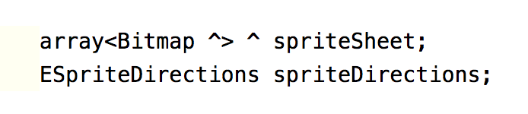
Modify Sprite.h
Modify your Sprite class (in the .h)

Slide 7
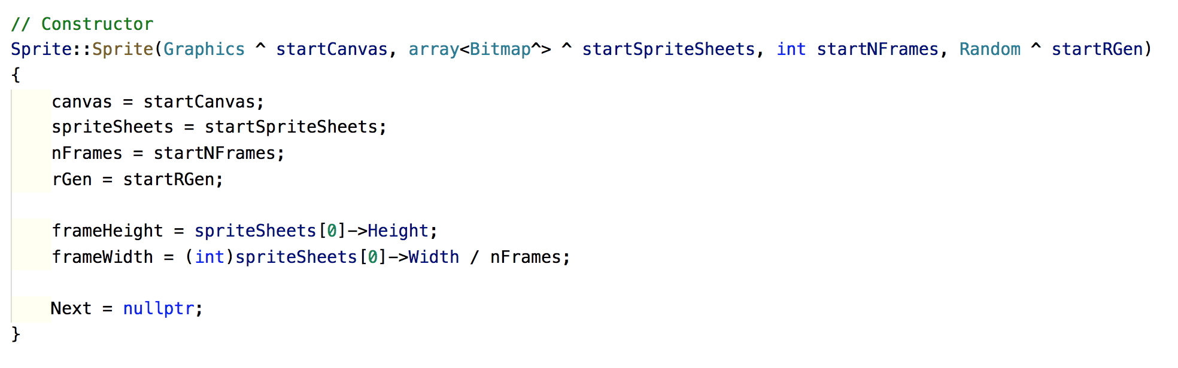
Modify Sprite.cpp
Modify your Sprite constructor

Slide 8
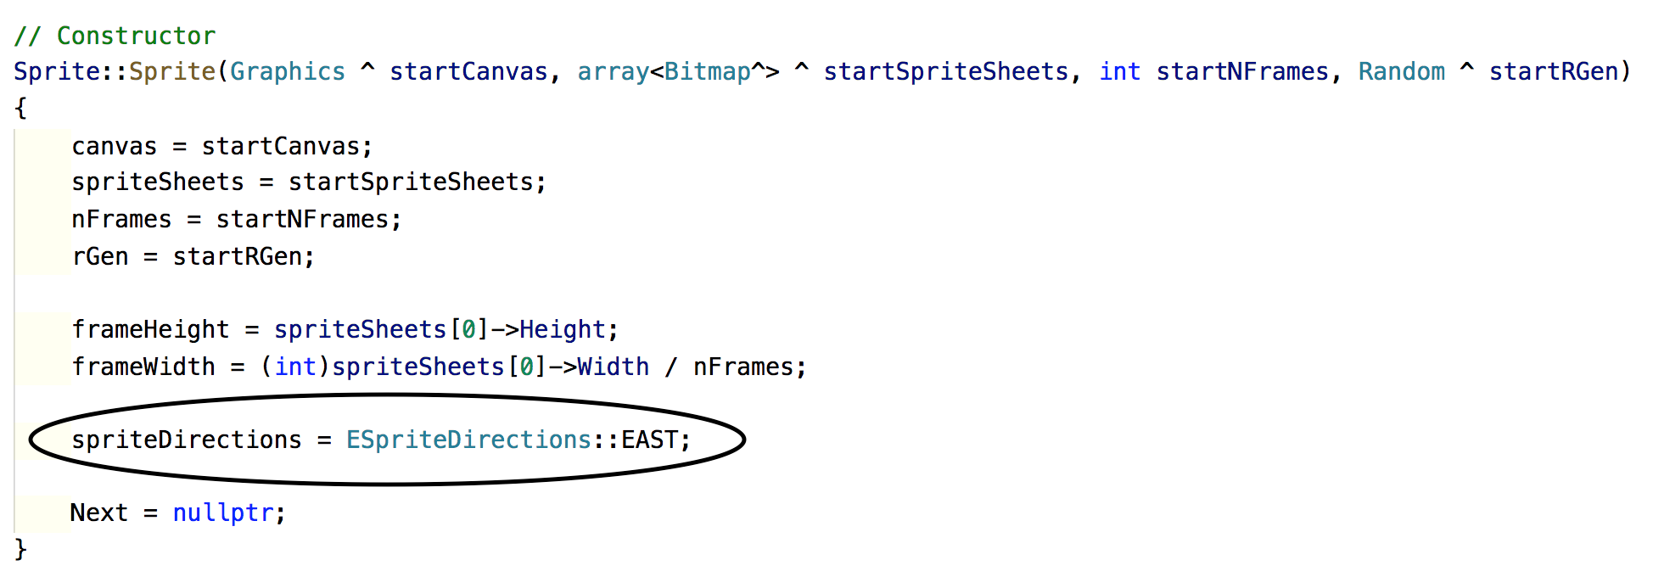
Modify Sprite.cpp
Give the sprite’s direction a default value

Slide 9
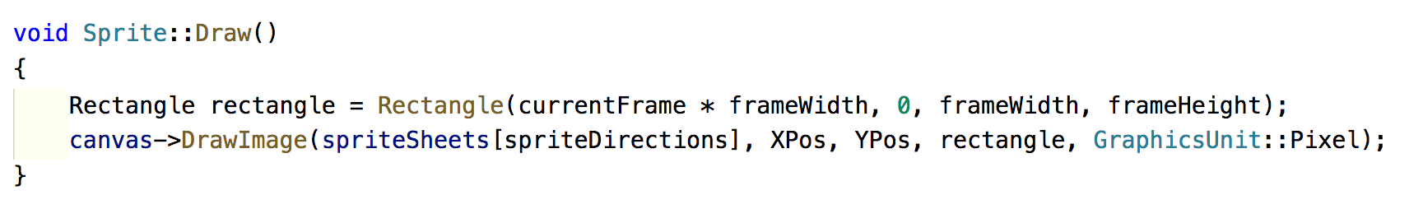
Drawing sprite
We should think about writing maintainable code
Make use of intermediate variables
Note my X and Y position are properties

Slide 10
Moving sprite
Velocities need to be separated into a magnitude
and a direction
Let xVel and yVel now represent the magnitude of
a single step
Add direction properties to control the x and y
direction of movement
Direction values = {-1, 0, 1}
One direction value for x/horizontal movement
and one for y/vertical movement
To control the axis (direction) of movement, multiply
the velocities by their direction values
Add the results to xPos and yPos

Slide 11
Moving sprite
Example:
Assume xVel = 5 and yVel = 5
What are the xDirection and yDirection values
to move:
East?
South?
West?
North?
In each case we would compute:
xPos += (xVel * xDirection)
yPos += (yVel * yDirection)

Slide 12
Moving sprite
If direction is | Multiply xVel by | Multiply yVel by
EAST | 1 | 0
SOUTH | 0 | 1
WEST | -1 | 0
NORTH | 0 | -1

Slide 13

Moving sprite
Assume an array<Point>^ velocityDirections represents this table:
If direction is | Multiply xVel by | Multiply yVel by
EAST | 1 | 0
SOUTH | 0 | 1
WEST | -1 | 0
NORTH | 0 | -1

Slide 14
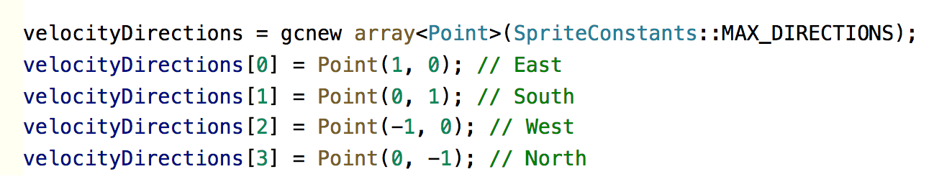
Velocity directions
Declare velocityDirections in Sprite.h
Instantiate velocityDirections in Sprite.cpp

Slide 15
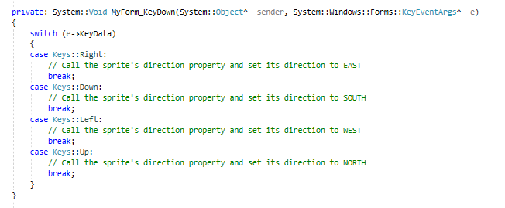
Controlling sprite
Key down event in MyForm.h

Slide 16
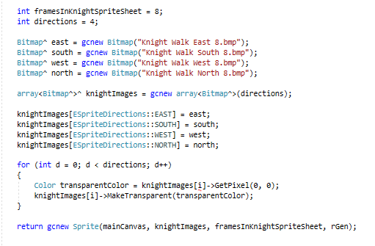
Creating sprite
Create a method called generateKnightSprite()

Slide 17
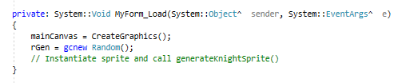
Initialisation

